Slide 1

DATA MODELING,VISUALIZATION AND SHARING IN MICROSOFT POWER BI

Slide 2


KEY OBJECTIVES
To practically understand what modelling is in Microsoft Power BI
To basically introduce the concept of DAX and a slight Application
To build a simple report and publish to Power BI service
Accessing these reports from Power BI Mobile

Slide 3
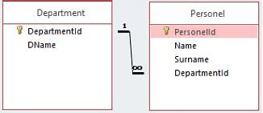
Modeling In Power BI
When we pull in Data into Microsoft Power BI, we bring in lots of Tables which really needs to be interconnected to enable a free-flowing insight in our visuals -that is giving our visuals the Ability to utilize columns from different Tables
A very important Concept in Modelling is "Primary and Secondary(Foreign) Key"

Slide 4
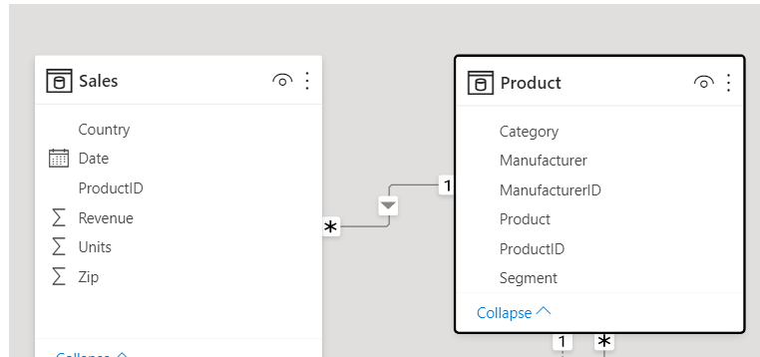
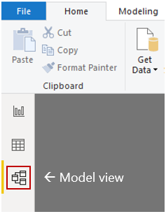
Modelling in Power BI
Modelling In Power BI is done in Model Tab
To create a relationship between tables, you drag a column (Primary Key)and drop it on the other column(Secondary Key) to be used to build the relationship e.g. in the product Below, the Productid(Primary Key) is used to connect the Productid(Secondary Key)

Slide 5
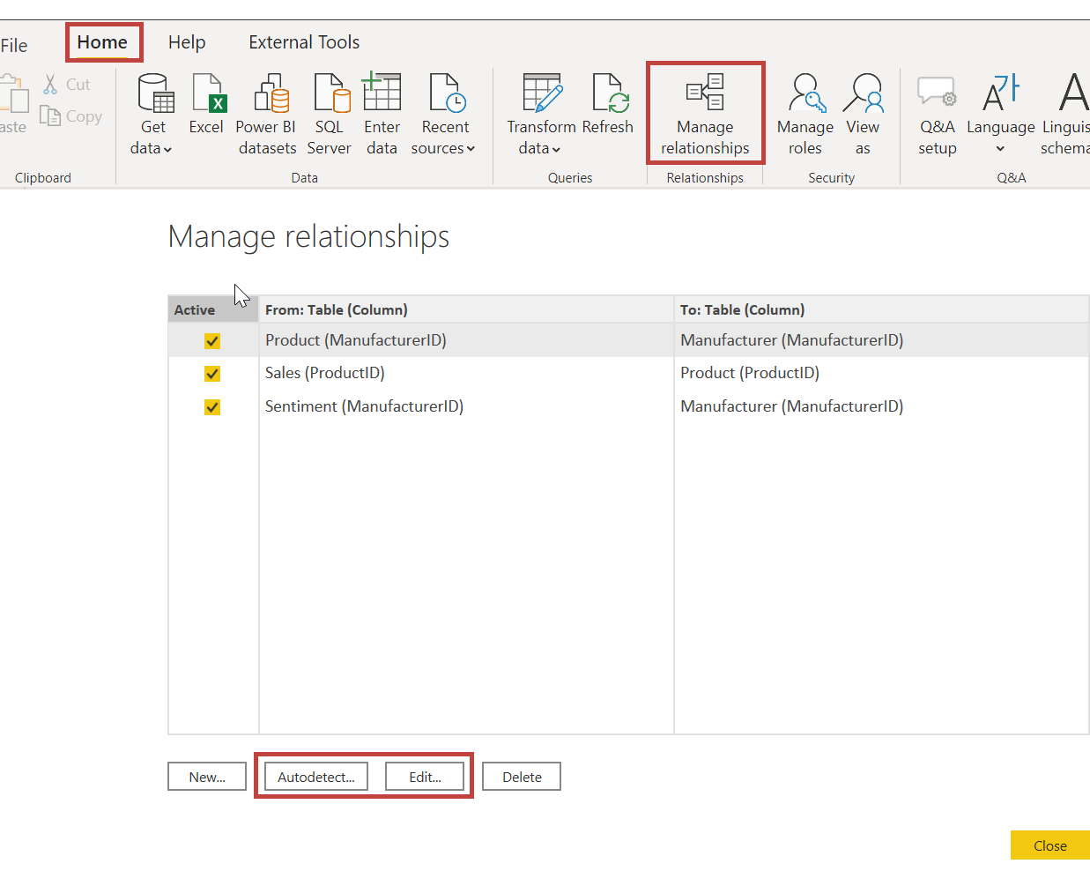
Modeling In Power BI
To view the relationship between your table as a list, you can access it via Manage relationships as can be seen in the chart.
This is important as relationships can arise from auto-detection..... You have the option to edit or delete any relationship

Slide 6
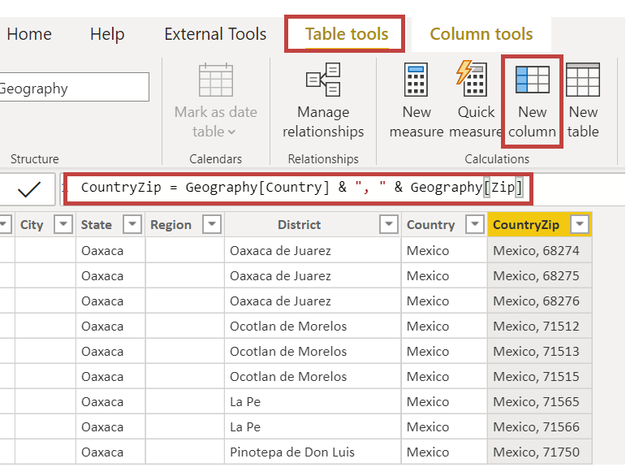
DAX and Calculated Column
DAX means Data Analysis Expression – this is the Power BI language that is used to unlock the functions for carrying out tasks or calculations in Power BI
Calculated Columns: Sometimes there's need to create new columns when that'll be needed to create relationships....as can be seen in the attached picture

Slide 7
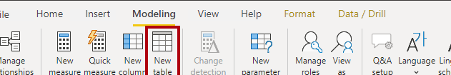
Creating a Calculated Table
It is sometimes necessary to create a calculated date table for the purpose of relationship (Modeling) which will assist in enriching insights from our analysis. This is key to making our analysis a time Intelligent one.
Steps to creating a calculated Table are:
A)On the ribbon, click on the Modeling tab and select new table
B) On the formula Bar, to create a date Table, you use the calendarauto() function to import date from existing table. Thereafter, you can click on enter, to get your Table and then further column population can be done with calculated column. To learn more about this check out Microsoft Learn.

Slide 8
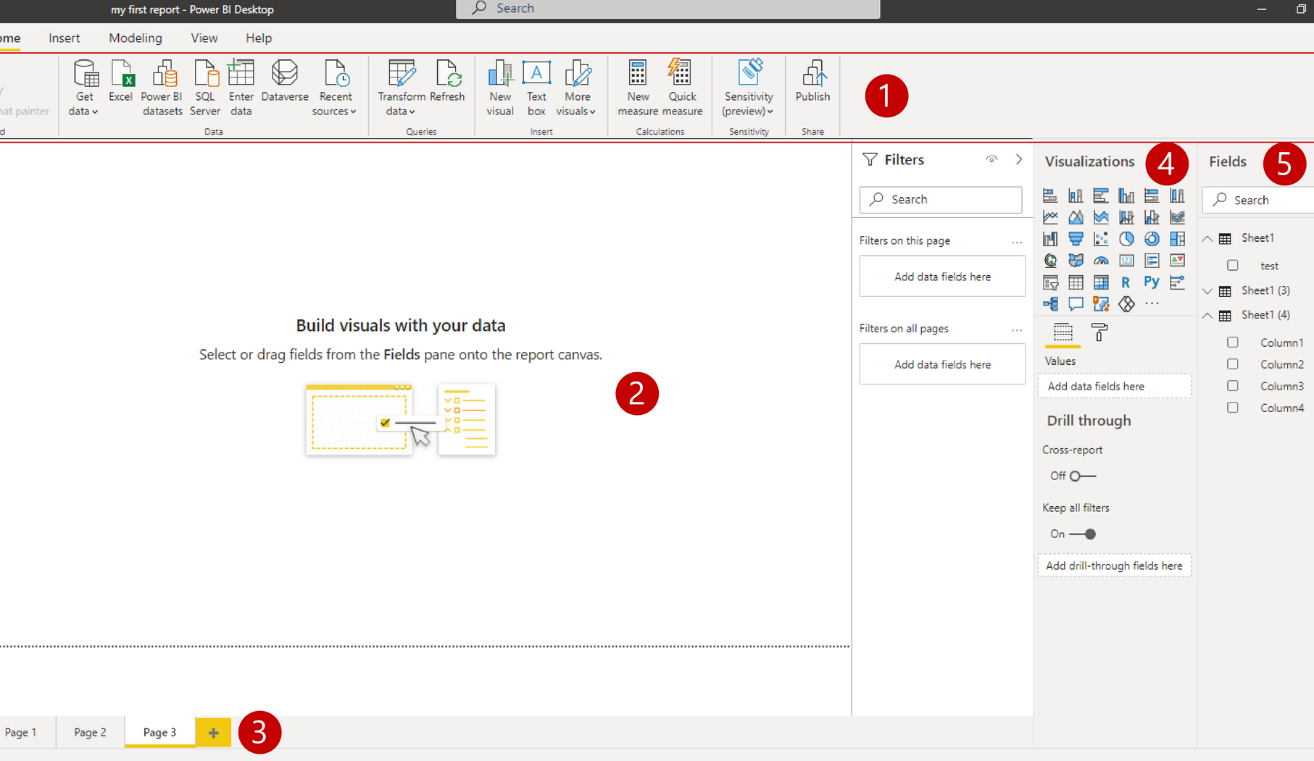
Visualization in Power BI
We went through all the previous processes, so we can have a suitable data to feed the visuals so as to build reports (that is the collection of visuals) that reflects the situation of the Business
Reporting which involves the use of visuals is carried out on the Report view as can be seen in the appended charts:

Slide 9
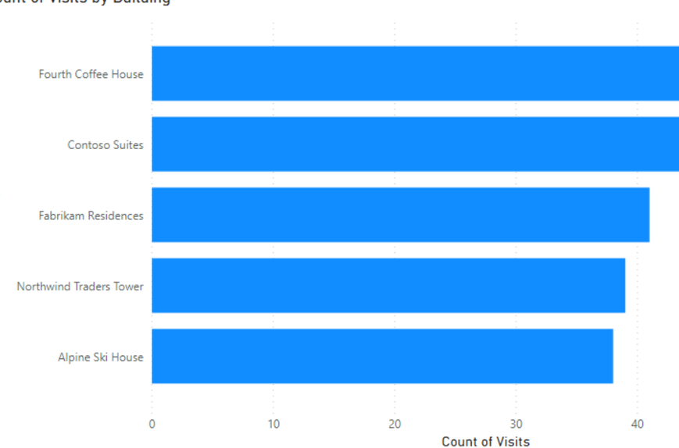
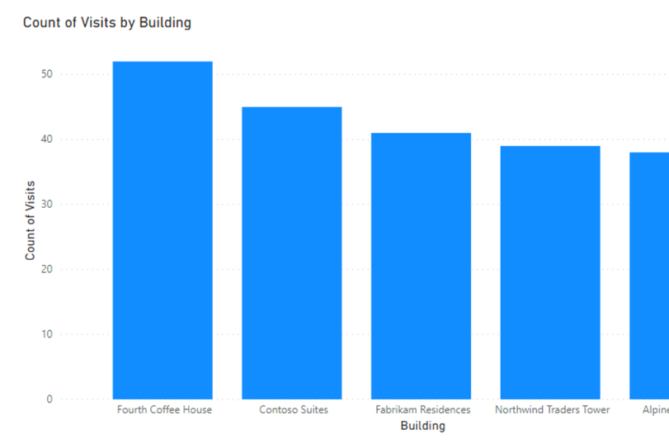
VISUALS IN POWER BI
We can't talk of Reports without having to talk about Visuals
Some Key Visuals are :
1) Bar and Column charts: Bar charts are the standard for looking at a specific value across different categories

Slide 10

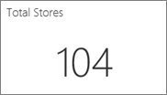
VISUALS IN POWER BI
2) Card Visual: This is an excellent visual for summarizing our data. It is often used to give a snapshot of what the data is speaking

Slide 11
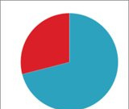
VISUALS IN POWER BI
2) Pie Chart Visual: This is a chart that's used to show relationship of parts to a whole

Slide 12
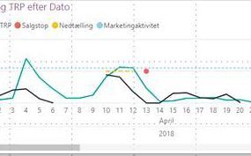
VISUALS IN POWER BI
3)Line chart Visual: This visual is ideal to show trend over time. It's used in time Series analysis

Slide 13
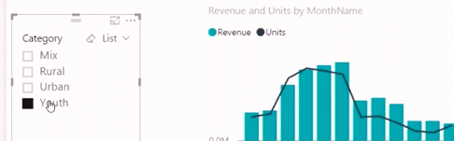
VISUALS IN POWER BI
4) Slicers: This is a visual that can be used to filter on a given report page

Slide 14
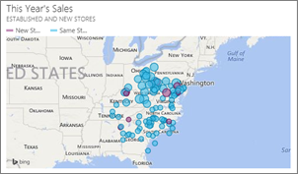
Visuals In Power BI
5) Maps: This is used to visualize geographical data, for a more comprehensible insight.

Slide 15
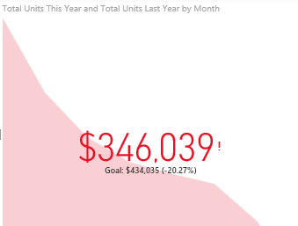
VISUALS In POWER BI
6) KPIs: (Key Performance Indices)- This visual Helps to track a goal. This can be used to measure the level of achievement of a business goal.

Slide 16
Building Reports In Power BI
Reports in Power BI is built by the collection of visuals that has been discussed above, and it 's this report that can be Published to Power BI service for sharing and Consumption
A lab will be Available through this Link: https://bit.ly/BuildingAndPublishingPowerBIReports, where you can you'll have a hands on experience on how to develop and share reports.

Slide 17
Accessing Reports Via Microsoft Power BI Mobile
To Access your Power BI Report On mobile, after you've gotten your App from Play store, proceed to sign in with the same Microsoft account used for your Power BI Service to access your workspaces, reports and Dashboards

Slide 18
Thanks for your Rapt Attention!

